Slide 1
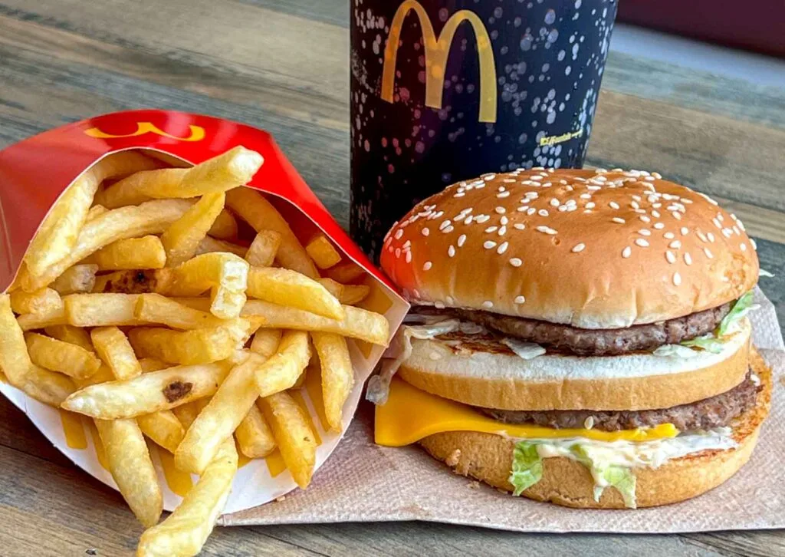

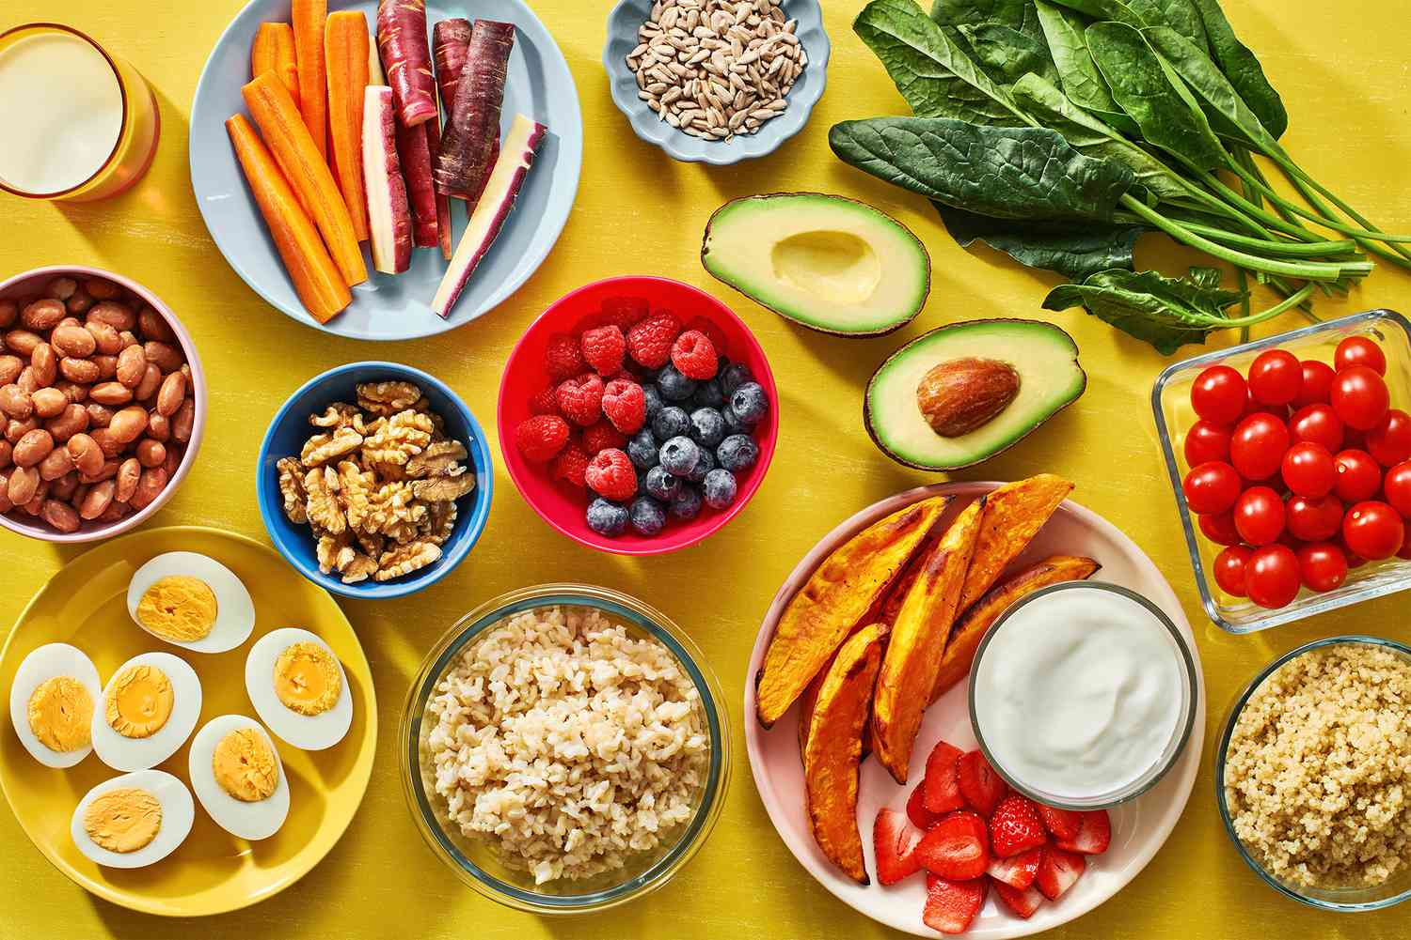




Do Social Media Users Interact More with Fast Food or Healthy Food Online?
David D Berberena
Bellevue University
DSC 500 Introduction to Data Science
Nasheb Ismaily
October 29, 2023

Slide 2
Overview: Social Media and Food Awareness
Social media posts regarding food are some of the most prolific examples of the abundance of user interaction
We all consume food on a daily basis, yet how does that translate into social media interaction?
Fast food versus healthy food: Which one garners the most online interaction?

Slide 3
Overview: Initial Explorative Thoughts
To begin our journey of analyzing the main topic at hand, discovery questions to address sub-topics lead to greater understanding
Where in the world are online users classified as generally drawn more toward fast food as opposed to healthy food options?
Do “food influencers” play a role in social media users’ food consumption and interaction based on the type of food (healthy or fast food) they post?

Slide 4
Analysis Strategy
In the face of quantifying likes, shares, comments, clicks, etc., what can be done to begin the data collection process?
Various avenues can be used to gather and analyze relevant data, such as:
Google Trends
Social Media Sites (Instagram)
Professional Research Studies

Slide 5
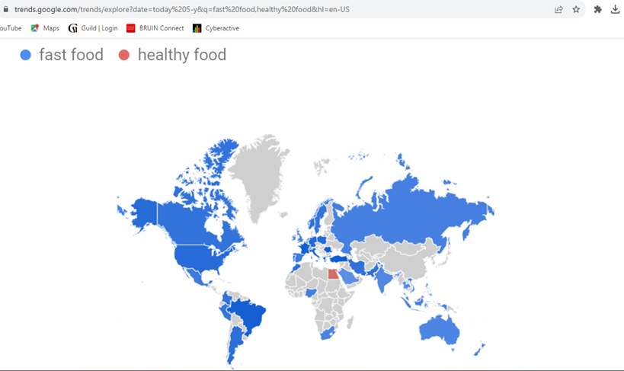
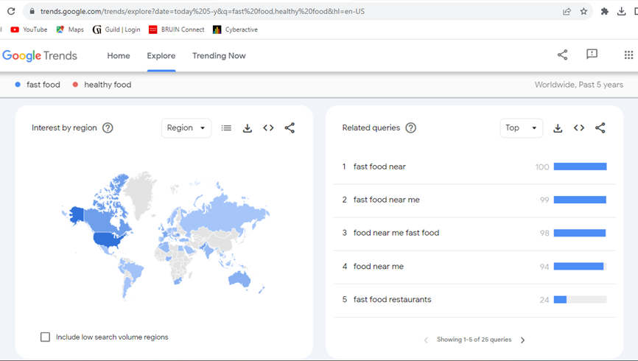
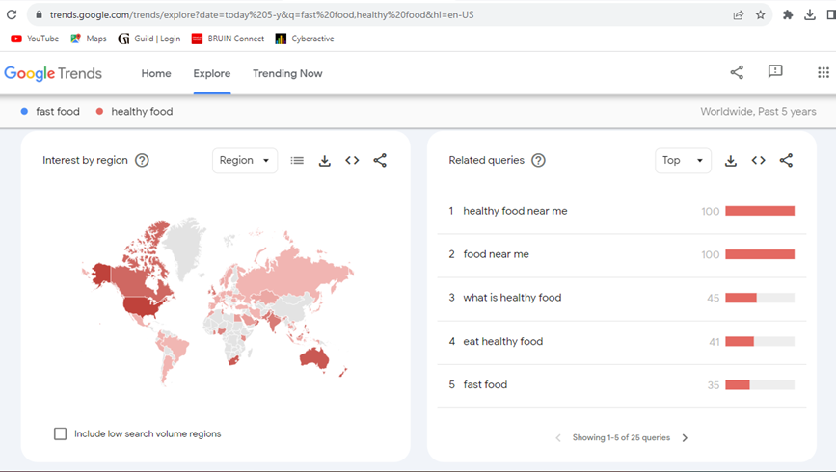
Google Trends: What does it all mean?

Slide 6

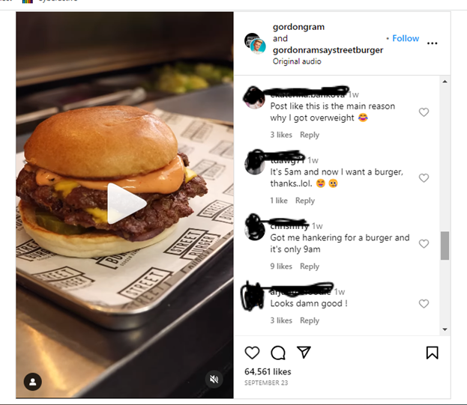
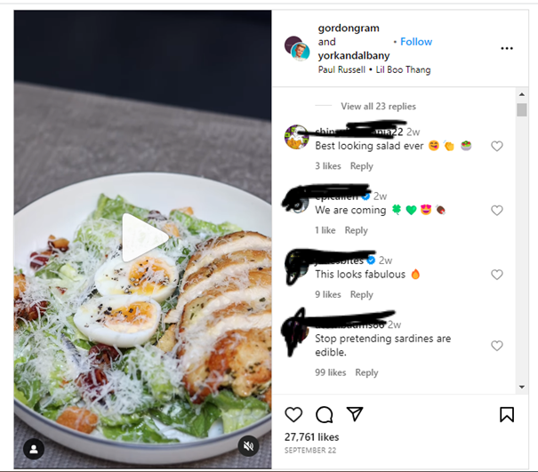
Instagram Page @Gordongram
What do the comments and likes tell you?

Slide 7

Data Analysis Findings
Google Trends
All countries save for three have a higher percentage of “fast food” searches
The top “fast food” and “healthy food” searches were “fast food near” and “healthy food near me” respectively
Instagram
A fast food post of a burger made by Gordon Ramsey garnered over 2.3 times the likes of a post made of a chicken Caesar salad within one day of each other

Slide 8
More Insights
Research Studies
Aston University: Individuals who viewed healthy food posts with a high level of “engagement” ate more healthy food options available under a controlled environment
Pew Research Center: 58 percent of Americans surveyed said that they are aware that they need to be eating healthier, yet are not doing so
Sensodyne: Of the 2,000 surveyed, 37 percent shared that they ate comfort food every day, while another 38 percent ate comfort food every other day

Slide 9
What’s Next?
Gather additional data: Demographic information on users
Challenges: How can the gathering of data ensure that the population of social media users is interacting with the respective posts truthfully and without coercion or improper stimulation by outside forces?
Opportunities: The ability to increase positive interaction from social media users by learning to master the elements of a fast food or healthy food post that drive users to participate on an altruistic level is very desirable to strive for

